Slide 1

Data Structures & Algorithm
Queue Data Structure

Slide 2
Introduction
A queue is a linear list in which data can be inserted at one end, called the rear, and deleted from the other end, called the front.
It is a first in – first out (FIFO) restricted data structure.
Example
- A line at the supermarket

Slide 3
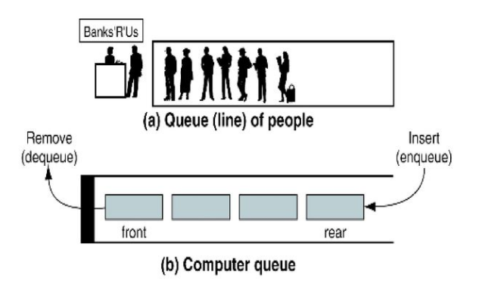
Queue Concept

Slide 4
Operations on Queue
Enqueue() – add (store) an item to the queue.
Dequeue() – remove an item from the queue.
Peek()/Queue front() - Gets the element at the front of the queue
without removing it.
Queue rear() – Gets the element at the rear of the queue without
removing it.
Isfull() – Checks if the queue is full.
Isempty() – Checks if the queue is empty.

Slide 5
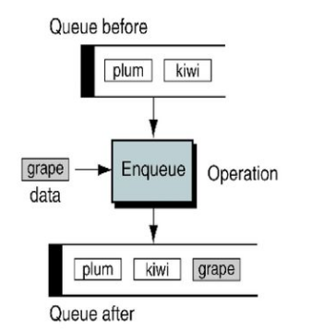
Enqueue Operation
Step 1 – Check if the queue is full.
Step 2 – If the queue is full, produce
overflow error and exit.
Step 3 – If the queue is not full,
increment rear pointer to point the
next empty space.
Step 4 – Add data element to the queue
location, where the rear is pointing.
Step 5 – return success.

Slide 6
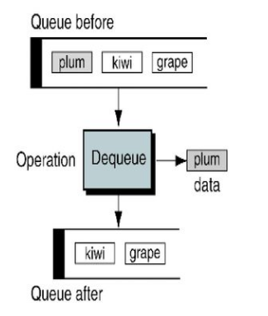
Dequeue Operation
Step 1 – Check if the queue is empty.
Step 2 – If the queue is empty, produce
underflow error and exit.
Step 3 – If the queue is not empty, access
the data where front is pointing.
Step 4 – Increment front pointer to point
to the next available data element.
Step 5 – Return success.

Slide 7
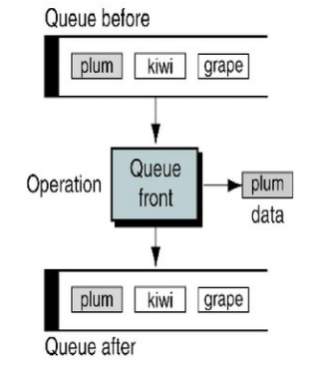
Peek()/Queue front()

Slide 8
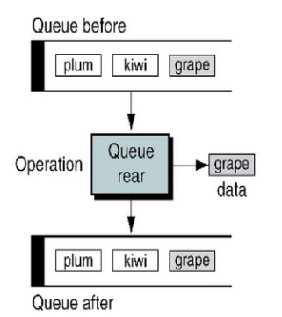
Queue rear()

Slide 9
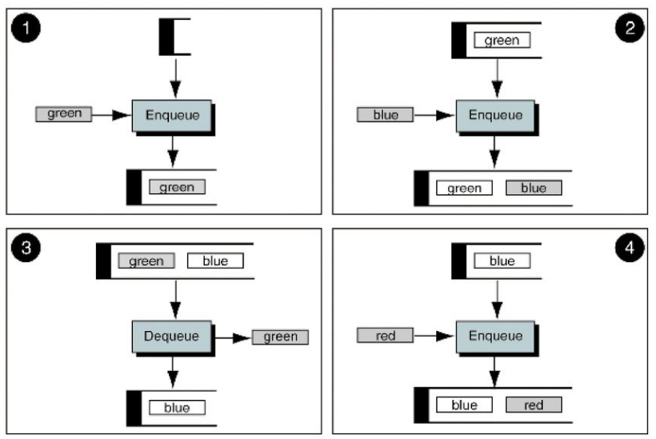
Queue Example

Slide 10
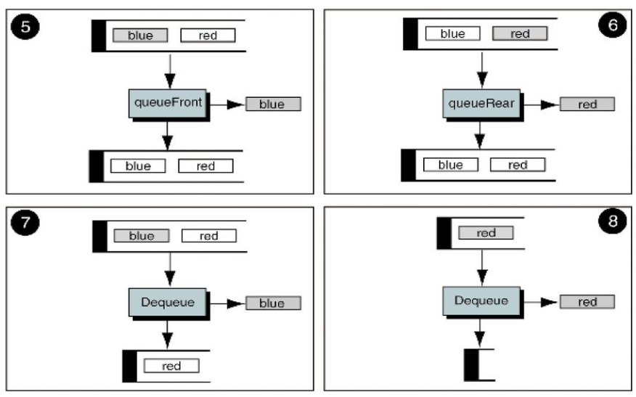
Queue Example (continued)

Slide 11
Implementing a Queue
Just like a stack, we can implementing a queue in two ways:
Using an array
Using a linked list

Slide 12
Implementing a Queue
Using an array to implement a queue is significantly harder than using an array to implement a stack. Why?
- Unlike a stack, where we add and remove at the same end, in a queue we add to one end and remove from the other.

Slide 13
Implementing a Queue
Implementing a queue using a array:
Enqueue at data[rear+1]
Dequeue at data[front]
The rear variable always contains the index of the last item in the queue.
The front variable always contains the index of the first item in the queue.
When we reach the end of the array, wrap around to the front again.

Slide 14
Implementing a Queue
Implementing a queue using a linked list is still easy:
Front of the queue is stored as the head node of the linked list, rear of the
queue is stored as the tail node.
Enqueue by adding to the end of the list
Dequeue by removing from the front of the list.

Slide 15
Application of Queue
Queue is useful in CPU scheduling, Disk Scheduling.
When data is transferred asynchronously between two processes. Queue is used for synchronization. Examples: IO Buffers, pipes, file IO, etc.
In real life, Call Center phone systems will use Queues, to hold people calling them in an order, until a service representative is free.

Slide 16
Thank You

